Slide 1
ACT 13
Not Bad Luck –
Bad Legislation
Marcellus Outreach Butler
April 19, 2012

Slide 2
Battle in the State House -- Grass Roots Opposition
Passed in party-line vote in the State Senate.
Floundered in the House the next day – couldn’t muster the votes to pass. House floor literally lit up with cell phone lights of calls to legislators to oppose passage.
Took arm twisting by Governor and Republican leadership to pass the next day.
Signed into law by Governor on February 14, 2012.

Slide 3
Sleight of Hand – the Impact Fee
“Sleight of Hand” --
2. deceptive skill
any kind of skill by which something happens without it being obvious how it is done.
Almost all discussion by politicians and media coverage in the run up to passage of Act 13 focused on the impact fee.

Slide 4
But the real deal -- the gift of almost total control to the gas industry:
“Under the guise of providing “impact fees” to municipalities where gas operations occur, the legislature effectively supported a takeover of municipalities by the State and the gas industry by gutting established and effective local planning and zoning rights.”
Wanda Guthrie, Murrysville Marcellus

Slide 5
What the Industry Paid
Tom Corbett received over $1.6 million campaign contributions from the gas industry.
In just 2009-2010 alone, he received $1,083,315 from just 216 donors related to the industry.
Overall, the gas industry increased its donations to political campaigns and PACs by 260%.*
*Common Cause PA

Slide 6
What the Industry Will Pay
Why Impact fee:
It’s chump change compared to a severance tax
It distracted attention from the other provisions of the proposed legislation which became Act 13
It also buys cooperation of municipalities—if they resist they do not get a share of the proceeds.
*Common Cause PA

Slide 7
Impact fee is $190,000 to $355,000 per well over the first 15 years the well is active.
The amount of the fee paid is variable, smaller when the price of gas extracted is low, greater when it’s higher, plus it’s also based on the current Consumer Price Index. (Just like your taxes, right?)
Not that you’ll know what they’re paying--PUC fee collection data not available to the public.

Slide 8
Impact fees paid out in a priority scheme:
First, to County Conservation Districts, Fish and Boat Commission, PUC, DEP, and other such agencies;
60% of remaining funds distributed to counties and municipalities as follows:
36% to counties with unconventional gas wells;
37% to municipalities with unconventional gas wells; and
27% to municipalities without unconventional wells but located in counties with them.

Slide 9
Remaining 40% deposited in the “Marcellus Legacy Fund” to be used for variety of statewide purposes, including 5% to underwrite development of private industries associated with gas drilling.
Examples:
$490,000 awarded to Aliquippa and Ohio River Railroad to establish an ethane cracker plant in Monaca, Beaver County
Subsidies for natural gas vehicles program

Slide 10
Limit on amount a municipality may receive: the lesser of 50% of their annual budget or $500,000.
Revenue that will be generated by wells in Butler County:
$45,000 to $60,000 (depending on price for the gas) for each fracked well
County Controller estimated County will receive $1 million directly, and another $500,000 from state infrastructure projects
Another source* estimates Butler will receive $706,320 .
In either case, it won’t pay for much. Example: The Glade Run Lake restoration (unrelated to gas drilling) will cost $4.2 million.
*StateImpact,

Slide 11
What and How Do We Pay?

Slide 12
Loss of Local Control What little there was is taken away
Prior to Act 13: preemption of municipal regulation by the Oil and Gas Act required drilling to be somewhere within municipality.
Pennsylvania Municipalities Planning Code (MPC) authorizes local governments to adopt zoning ordinances, and since 2000 has required “the reasonable development” of gas and oil, among other minerals.
Pennsylvania courts allowed municipalities discretion of what “reasonable development” meant, allowing zoning ordinances restricting where and how such activity was conducted.

Slide 13
In 2009, the Pennsylvania Supreme Court ruled municipalities could restrict gas wells to certain zoning districts as long as “reasonable” and supported legitimate zoning purposes (such as protection of residential neighborhoods, schools, hospitals, etc.)
Could allow as a “conditional use” requiring company to meet conditions designed to protect public health and welfare
Act 13 makes drilling a “permitted use” entitling companies to drill as a matter of right.

Slide 14
Act 13 imposes state wide definition of “reasonable development”:
Requires municipalities to allow gas drilling activity in all zoning districts, including residential areas, subject only to mandated setback requirements. Municipality may comment on, but cannot challenge issuance of permits
Eliminates the power of local governments to manage where and how drilling occurs within its borders
Strikes down any previously adopted ordinance and gives the Public Utility Commission (PUC) the authority to invalidate ordinances that conflict with gas operations.

Slide 15
PUC In Charge
PUC proceedings are not required to be public—Act 13 exempt from Sunshine Act and any rulemaking exempt from Commonwealth Documents Law and Regulatory Review Act.
Lets be clear: the PUC, an appointed agency with little experience in gas drilling activity, has been given the power to declare legally enacted local ordinances invalid and there is little recourse for a municipality.

Slide 16
Act 13 Improved Setbacks
Supporters claim Act 13 is provides more protection because of increased setback requirements.
Setbacks are still woefully inadequate to protect health and property value of area residents.

Slide 17
What Are The Setbacks?
Setback From: | Prior to Act 13 | After Act 13
Gas well head:
Building | 200 feet | 500 feet
Water wells | 200 feet | 500 feet
Water supply (public) |  | 1000 feet
Stream, spring, body of water or wetland greater than 1 acre in size | 100 feet | 300 feet
Drill pad |  | 300 feet
Impoundment (frack) pond |  | 300 feet
Compressor station |  | 750 feet from nearest building 200 feet from property line
Processing plant |  | 750 feet from nearest building 200 feet from property line
Pipelines |  | None

Slide 18
Waivers: A gas driller can request a waiver from the DEP of setback requirements if additional protective measures employed, even if the landowner has refused to waive the requirements.
New setback restrictions do not apply to existing well sites with existing well permit

Slide 19
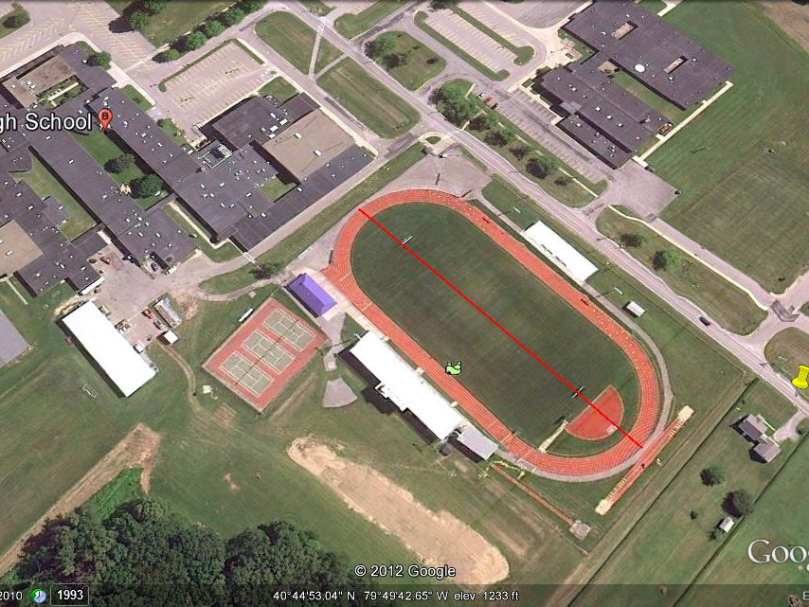
What Do The Setbacks Look Like?
This school athletic field is 575 feet long (red line). Act 13 ‘improved’ setback is 500 feet from nearest building to well head bore.

Slide 20
Improved “Rebuttable Presumption”
The presumption of liability of gas driller for pollution of a water supply occurring within a set distance and within specified time period after drilling, stimulation or other alteration.
Gas driller must supply temporary replacement water, but does not have to clean up the water supply.
Does not apply to quantity or amount of water supply changes.
Well Type | Distance From Well | Period From Activity
Conventional | 1,000 feet | 6 months
Unconventional (frack) | 2,500 feet | 12 months

Slide 21
Public Disclosure Notification of Drilling
Driller must identify water supplies within 3,000 feet at time of permit application for proposed gas unconventional gas well
Must provide copy of portion of application to surface landowner, any municipality within 3,000 feet, and owner/lessee of any coal seams that will be beneath the well.
Notice must advise owner’s it is in their interest to get independent water tests.

Slide 22
Public Disclosure Notification of Drilling
Drillers are not required to perform pre-drill tests of any nearby water supplies. (Usually do according to their own company policy.)
Drillers must provide 24-hour notification before drilling begins to landowner, local municipality, and DEP.

Slide 23
Public Disclosure Health and Safety
Industry may still claim fracking chemicals are “confidential proprietary information” or “Trade Secrets,” and not disclose what chemicals or how much of them are being used.
Physicians and other health providers can have access for patient treatment but only after submitting written requests and they may not share that knowledge.

Slide 24
“Trade secrets” available to Public health officials who determine a medical emergency exists, but if requested by driller must confirm the need for the information, and must limit its use to purpose stated and keep it confidential.
Health officials and first responders may receive the information in cases of spill or release, but must submit written request.
No way to challenge company’s claim that the chemicals and amounts used are “confidential proprietary information.”

Slide 25
Why do supporters of the Act say there is disclosure of fracking chemicals?
Act provides for well completion reports to be filed with DEP listing chemicals and additives and percent by mass of, but may identify portions as a “confidential proprietary information,” which the DEP is prohibited from disclosing.
Act provides for creation of an online, searchable registry of chemicals, with drilling companies uploading chemical data 60 days after fracking has commenced on a particular well.
But, a company may still claim a chemical or concentration is a trade secret and instead submit more generic information.

Slide 26
No burden on anyone to ensure accuracy of information on registry:
Vendors have no liability for any misinformation provided to them by third parties
Service providers have no liability for any misinformation provided to them by vendors
Drilling companies have no liability for any misinformation provided to them by vendors or service providers

Slide 27
Does the protection of confidential proprietary information create a “gag order”?
Many in the medical profession have serious concerns about the confidentiality imposed on them with respect to information and knowledge they obtain with respect to treatment of a patient, that has public health implications.
“I have never seen anything like this in my 37 years of practice…” -- Dr. Helen Podgainy, a pediatrician from Coraopolis, Pa.

Slide 28
[The law] “is detrimental to the delivery of personal health care and contradictory to the ethical principles of medicine and public health” –
Dr. Jerome Paulson, director of the Mid-Atlantic Center for Children’s Health and the Environment at the Children’s National Medical Center in Washington, D.C. Dr. Paulson, and professor of pediatrics at George Washington University.
Others express concern for the ability of health departments to collect information that would reveal trends that will enable them to protect the public health.

Slide 29
“Rather than providing health personnel with direction on how to prepare for potential exposures to toxic chemicals in the air, water or soil, or to accidents similar to those that already have occurred, the law sets up an obstacle course that health care providers must navigate to secure information about proprietary chemicals . . ..It is a breach of a physician's responsibilities not to report a public health threat, as well as a contradiction of established public health practice and law.”
BERNARD GOLDSTEIN and JILL KRIESKY
Pittsburgh Post-Gazette Opinion/Perspectives, March 11, 2012

