Slide 1
Protecting Your Family’s Health When “Fracking” is Your Neighbor
Raina Rippel, Director
April 7, 2018

Slide 2
Role of EHP in the Community
Respond to clients’ need
Assess individual health issues
Identify pathways of environmental exposure
Conduct air and water quality monitoring
Interpret air and water lab results
Monitor soil impacts
Work with clients to manage and improve their health and wellbeing
Notes:
Evaluation of health risks –EHP’s nurse practitioner works directly with those residents who believe their health may be impacted from UOGD. Pairing the env. data with health data allows for a bigger picture.
We Identify the Exposure pathways – which are inhalation, ingestion, direct contact
Env. Measurement Tools – we give residents monitors such as Speck air quality, CATTfish water quality,
Interpretation of air lab results – EHP been working with ALS Global, a lab out of Simi Valley CA to conduct SUMMA canister tests and then reporting the findings of the lab to residents after EHP’s toxicologist, Dave Brown has reviewed them.
Assessment of air exposure – After a resident monitors their air, EHP provides and analysis and explanation of the data in a report which is mailed to the resident. The report follows a ‘quick and to the point’ structure and contains visuals of the data, a summary of their exposure based on variables defined by EHP and recommendations on how to improve their environment and potentially lower the exposure.

Slide 3
Individual Health Exposure Assessment
Home Exposure Assessment
Notes:
These toolsEHP’s medical staff understand your environmental conditions and health concerns.

Slide 4
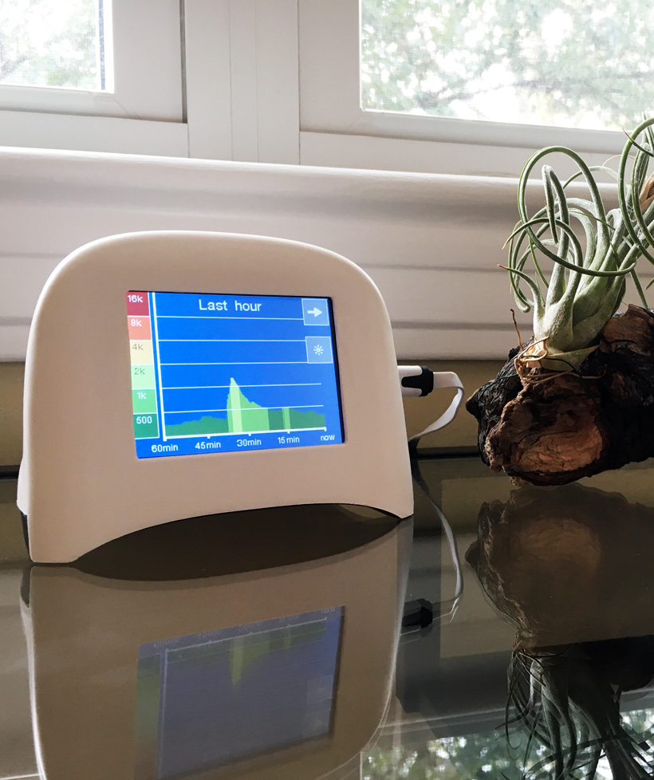
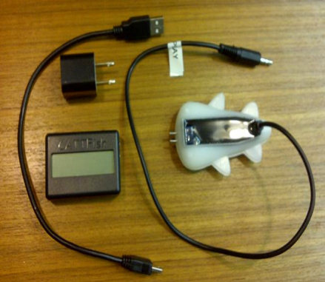
Emissions Monitoring
Speck
Air Quality Monitor
Monitors PM_{2.5}
CATTfish
Water Quality Monitor
Monitors total
dissolved solids
Notes:
EHP offers the use of monitors to residents at no charge.
The monitors are sold for ~ $200 and EHP chose to work with them because of how ‘user-friendly’ they are & their ability to record real-time data.
SPECK - The image shows the small size of the monitor, and also shows one of the 3 viewing modes the monitor offers. Right now it’s showing the 1-hour screen which shows data recorded within the last hour. The other 2 screen options are ‘current reading’ and ‘12-hour’
The color scheme of the monitor is unique in that it uses calm colors so that people are terribly alarmed when they see yellow, which is considered moderate by the EPA and occurs most days in southwestern PA.
The monitor is designed to save a data point every minute. Data points are made from 60 consecutive recordings averaged to create a 1-minute reading.
After a resident collects readings the monitor is returned to EHP where we download the data, analyze it and generate a report as quickly as possible. Upon request from the resident, EHP will mail the monitor back for another 32-day round of monitoring where we will repeat the process over again.
There is no limit to how many rounds people can use EHP monitors. We have worked with several residents for over a year which has given EHP a tremendous database to work from.
CATTFISH - – Conductivity And Temperature in Toilet tank
Conductivity is the ability of a sample of water to carry an electrical charge. The greater the charge the higher the conductivity will be.
Readings found to be above average for a sample of water generally means that there are unseen particles in the water. These particles can be anything from salts to larger complex molecules, some of which can be harmful to your health.
Interactive – show them the CATTfish

Slide 5
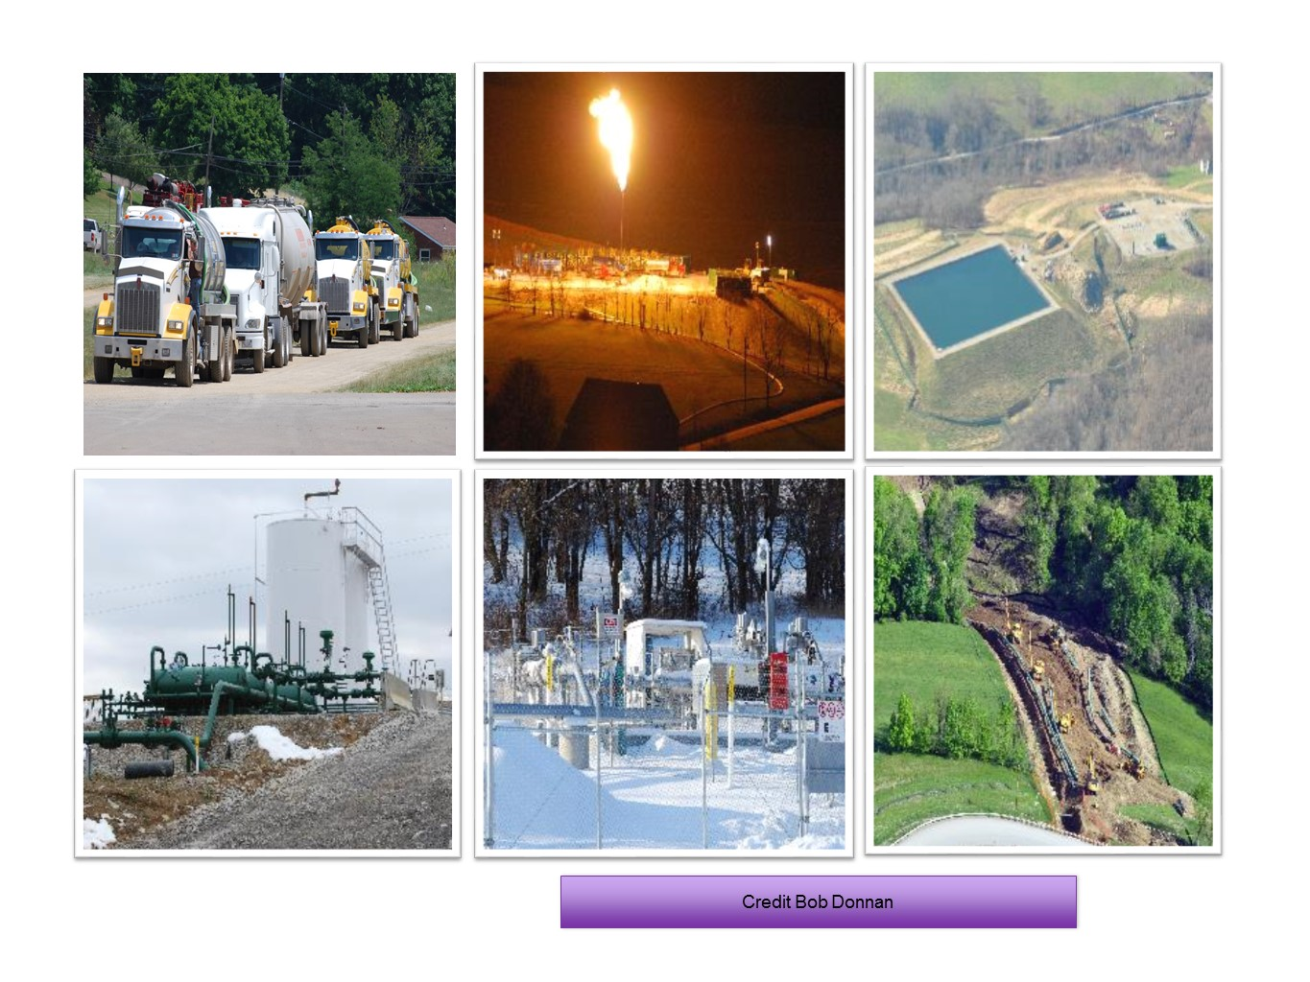
A Day in the Life of the Shalefields

Slide 6
Casing, Drilling, & Hydraulic Fracturing
AIR
VOCs
silica dust
diesel emissions
particulate matter (PM)
WATER
failure of well casings
methane migration
Photo by Bob Donnan
Notes:
Test wells drilled
Casing (cement/steel) for permanent well put in place
Pipes installed for barrier between flow of gas/fracking fluids and groundwater
Shale is fractured and frack fluid is injected into the well.
Flowback fluids return to the surface.

Slide 7
Compressor Station
AIR
methane
VOCs
nitrogen oxides
particulate matter (PM)
Photo by Bob Donnan
Notes:
Compressor stations help with the transportation of natural gas from one location to another
Gas pipelines that carry the natural gas must be constantly pressurized
Gas along with VOCs may be vented at these locations when pressure needs to be released and/or pipes cleaned.

Slide 8
Known VOCs in Shale Gas Emissions
Short-term Long-term
Chemical Exposure Exposure
Benzene
Headache, dizziness
Aplastic anemia, leukemia
Eye and throat irritation
Possible carcinogen
Ethyl benzene
Toluene
Headaches, sleepiness, confusion
Possible permanent neurological problems
Xylenes
Eye, nose, throat, and skin irritation
Possible permanent neurological effects
Notes:
These are also considered to be HAPS and Endocrine Disruptors

Slide 9
Some Other Known Chemicals and Effects
Short-term Long-term
Chemical Exposure Exposure
Formaldehyde
Nose & eye irritation, impaired short term memory, asthma attacks
Asthma, eczema, nasal & throat cancer
Eye, nose, throat & lung irritation, headaches dizziness, nausea
Worsening respiratory disease, lung cancer
Diesel Exhaust VOCs & PM2.5
Particulate Matter 2.5
Asthma attacks, acute bronchitis, possible heart attacks
Reduced lung function, chronic bronchitis
Notes:
This is not an exhaustive list and is but a sample. EHP has documentation on Acute and Chronic health effects of many different chemicals related to UOGD.

Slide 10
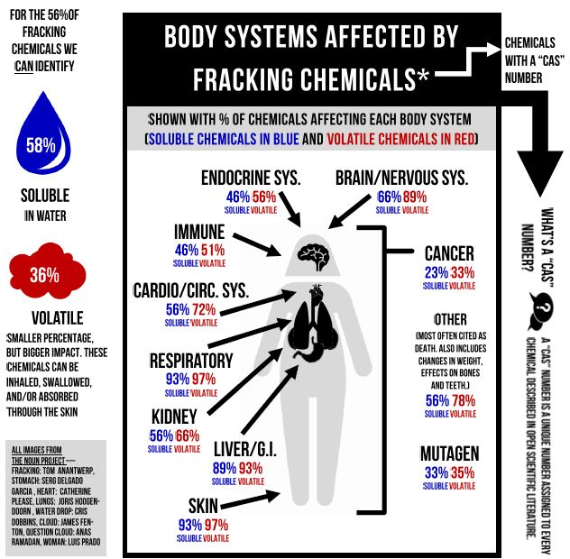
2013

Slide 11
Fracking and Health Research
**The health risks depicted in this graphic are aggregated from findings of separate peer-reviewed studies that have observed increased population health hazards, risks and impacts of living near oil and gas development. The graphic depicts the findings of the health studies cited in our paper and is not intended to indicate a causal relationship between oil and gas development and these health issues.
Notes:
What do we know about fracking and possible impacts to health? What are the health impacts associated with fracking?
Paper is “Toward Consistent Methodology to Quantify Populations in Proximity to Oil and Gas Development: A National Spatial Anaysis and Review” Environmental Health Perspectives August 23 2017 Online Edition
www.psehealthyenergy.org

Slide 12
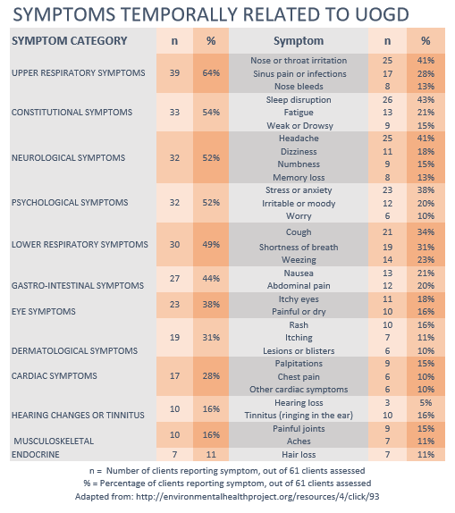
Findings from
EHP Health Intakes
Distance: within
1 km (0.6 miles)
Notes:
Study conducted by EHP on health assessments conducted by actual clients
Nov 8 2016
Emphasize correlation

Slide 13
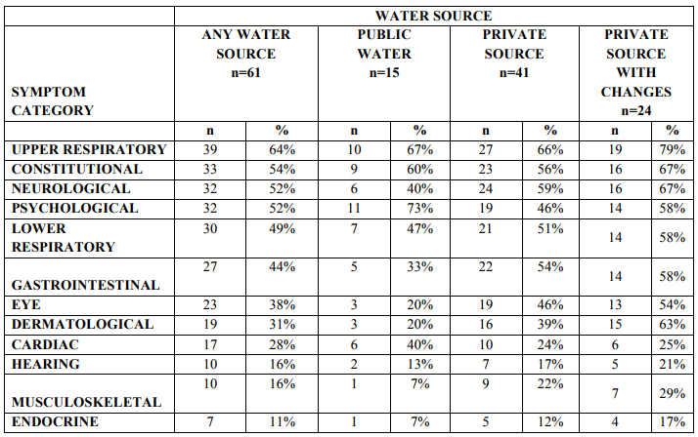
Symptoms Temporally Related
to Shale Gas Activity by Water Source
Findings from EHP health intakes
n = number of clients reporting symptoms, out of 61 clients assessed
% = percentage of clients reporting symptoms, out of 61 clients assessed
www.environmentalhealthproject.org/resources/4/click/93

Slide 14
Findings from EHP health intakes,
PA DEP 2016, PA Spatial Data Access 2016

Slide 15
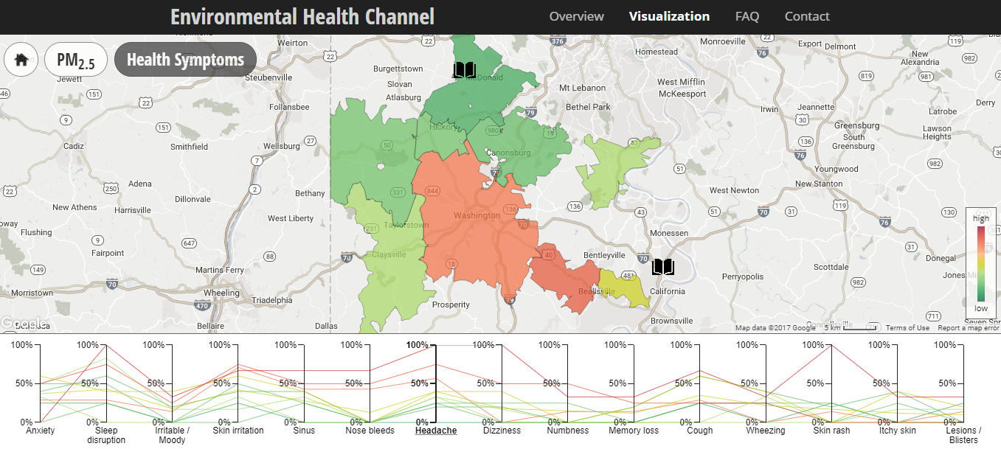
Environmental Health Channel
Visualizing Speck and Health Symptom Data by Zip Code

Slide 16
Why has EHP Launched a Registry?
Researchers can better understand the health effects;
Policy makers can recognize the size and scope of the public health problem (and implement protections);
EHP can provide on-going information from the registry data and emerging research on health effects; and
At the national scale, no one else is doing this, and only limited health registries exist in CO and PA.

Slide 17
Citizen Science
Toolkit
An online
interactive guide
Notes:
Collect information about and understand the fracking activity in your area
Everything from monitoring air for pm2.5, water for conductivity, noise levels. Being aware of how weather affects possible exposure.
Locate and document fracking activity in your community and around the region with the FracTracker tutorial,
Keep track of short- and long-term health symptoms
Use tools like the Speck air monitor and CATTfish water monitor
And many other steps to monitor, measure, and mitigate fracking exposures!

Slide 18
Contact Us
www.EnvironmentalHealthProject.org
724-260-5504
www.facebook.com/EnvironmentalHealthProject
@EHPinfo
EHP services and resources are free to the public

